Slide 1
WHAT IF JESUS HAD NEVER BEEN BORN?
PLEASANT VIEW, DECEMBER 22, 2019

Slide 2
GALATIANS 4:4
“But when the fullness of the time came, God sent forth His Son, born of a woman, born under the Law.”

Slide 3
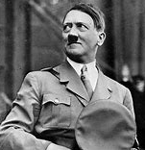
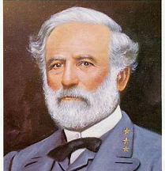
WHAT IF…

Slide 4
JOHN 1:14-18
“And the Word became flesh, and dwelt among us, and we saw His glory, glory as of the only begotten from the Father, full of grace and truth. John testified about Him and cried out, saying, "This was He of whom I said, 'He who comes after me has a higher rank than I, for He existed before me.'" For of His fullness we have all received, and grace upon grace. For the Law was given through Moses; grace and truth were realized through Jesus Christ. No one has seen God at any time; the only begotten God who is in the bosom of the Father, He has explained Him.”

Slide 5
#1 WE WOULD NOT KNOW WHAT GOD IS LIKE
Jesus was called Immanuel, which means “God with us” ( Matt. 1:23).
John 10:30 “I and the Father are one.”
John 14:9 “He who has seen Me has seen the Father.”
Your concept of God should match your concept of Jesus!

Slide 6
#2 We wouldN’t have victory over satan
I John 3:8 “The one who practices sin is of the devil; for the devil has sinned from the beginning. The Son of God appeared for this purpose, to destroy the works of the devil.”
The devil works against us…
MENTALLY
MOTIVATIONALLY
MORALLY

Slide 7
#3 WE WOULDN’T KNOW TRUE COMPASSION
Last year, Christians gave $358 billion to charity.
The two most famous parables in the Bible (Prodigal Son and Good Samaritan) deal with compassion.
Philippians 2:1-3 “Therefore if there is any encouragement in Christ, if there is any consolation of love, if there is any fellowship of the Spirit, if any affection and compassion, make my joy complete by being of the same mind, maintaining the same love, united in spirit, intent on one purpose. Do nothing from selfishness or empty conceit, but with humility of mind regard one another as more important than yourselves.”

Slide 8
CONCLUSION
Without Jesus, you would be condemned.
Without Jesus, you would not know God.
Without Jesus, you would have no hope.

